Slide 1

Web Development & Design Foundations with H T M L 5
Ninth Edition
Chapter 6
Page Layout
Slides in this presentation contain hyperlinks. JAWS users should be able to get a list of links by using INSERT+F7
Copyright © 2019, 2017, 2015 Pearson Education, Inc. All Rights Reserved
Notes:
If this PowerPoint presentation contains mathematical equations, you may need to check that your computer has the following installed:
1) MathType Plugin
2) Math Player (free versions available)
3) NVDA Reader (free versions available)

Slide 2
Learning Objectives
6.1 Describe and apply the C S S Box Model
6.2 Configure margin with C S S
6.3 Configure float with C S S
6.4 Configure fixed, relative, and absolute positioning with C S S
6.5 Create two-column page layouts using C S S
6.6 Configure navigation in unordered lists and style with C S S
6.7 Add interactivity to hyperlinks with C S S pseudo-classes
6.8 Configure web pages with H T M L 5 structural elements, including section, article, and aside

Slide 3
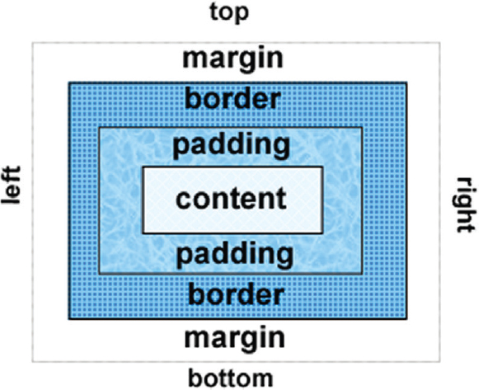
The Box Model
Content
Text & web page elements in the container
Padding
Area between the content and the border
Border
Between the padding and the margin
Margin
Determines the empty space between the element and adjacent elements

Slide 4
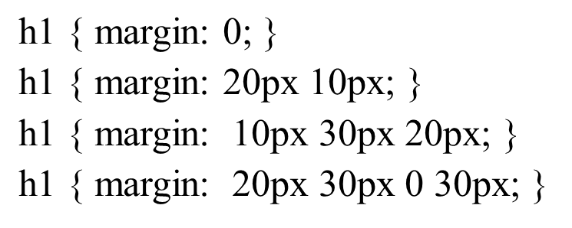
Configure Margin with C S S
The margin property
Related properties:
margin-top, margin-right, margin-left, margin-bottom
Configures empty space between the element and adjacent elements
Syntax examples

Slide 5
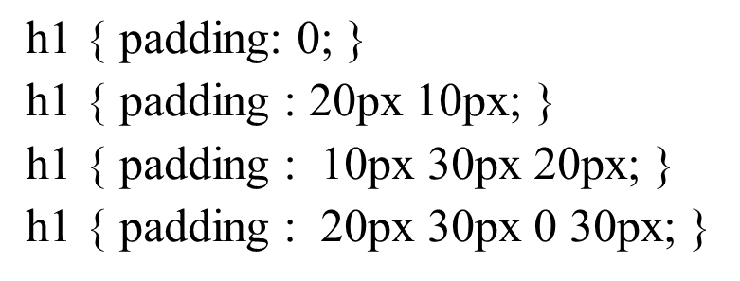
Configure Padding with C S S
The padding property
Related properties:
padding-top, padding-right, padding-left, padding-bottom
Configures empty space between the content of the H T M L element (such as text) and the border
Syntax examples

Slide 6
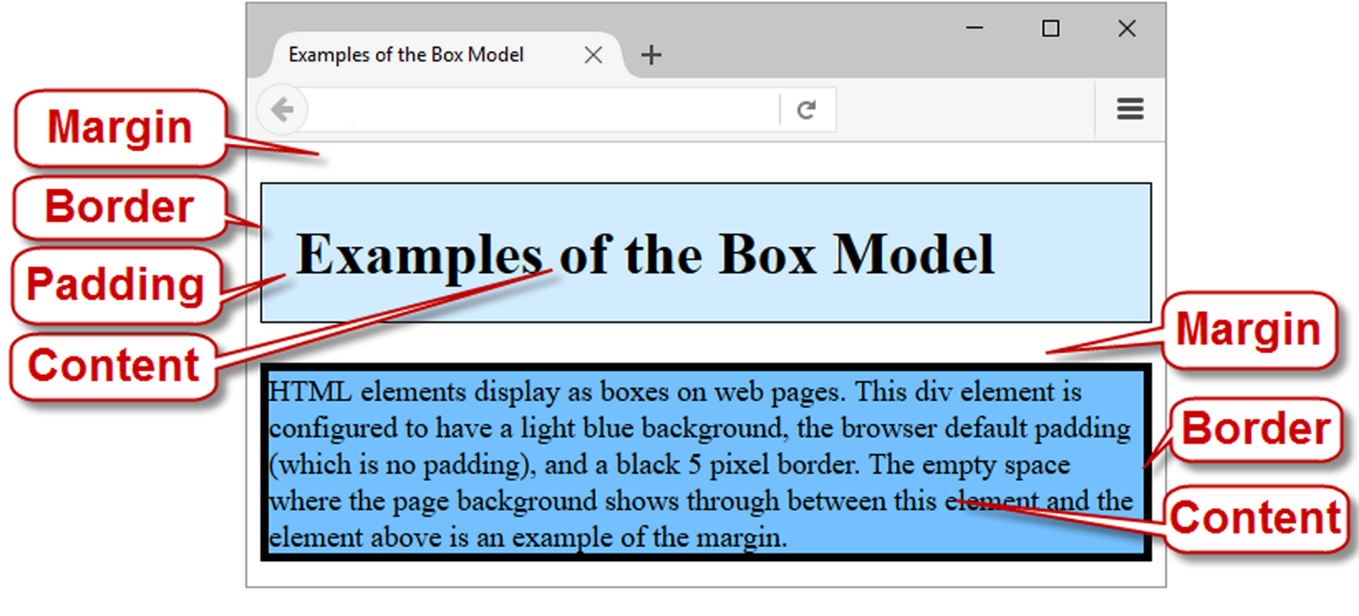
Box Model in Action

Slide 7
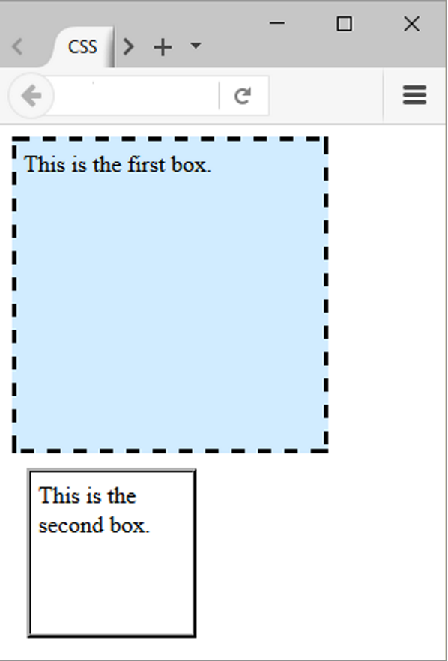
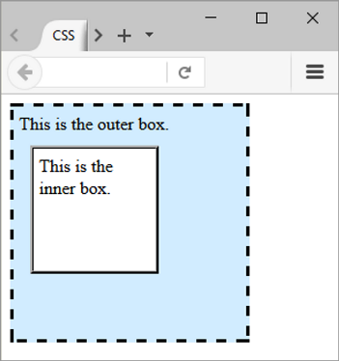
Normal Flow
Browser display of elements in the order they are coded in the web page document

Slide 8
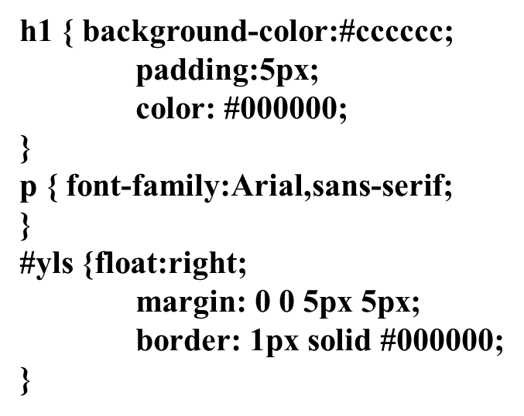
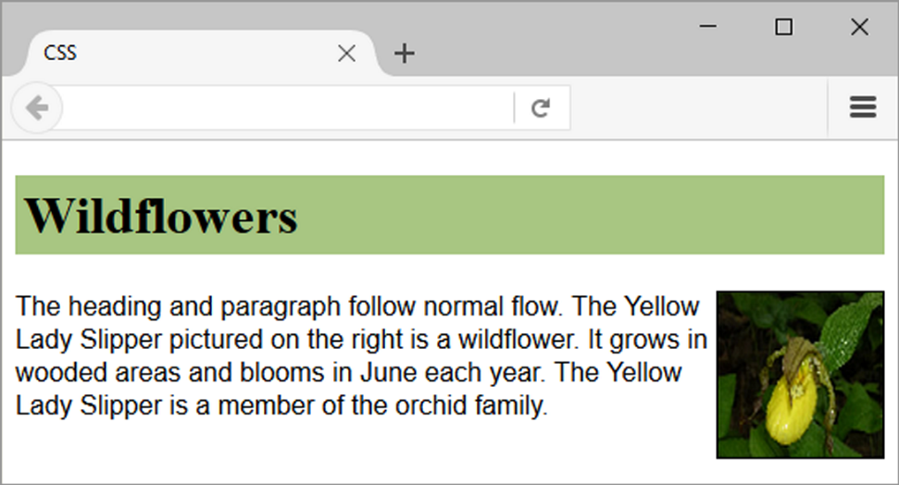
Float Property
Elements that seem to “float” on the right or left side of either the browser window or another element are often configured using the float property.

Slide 9
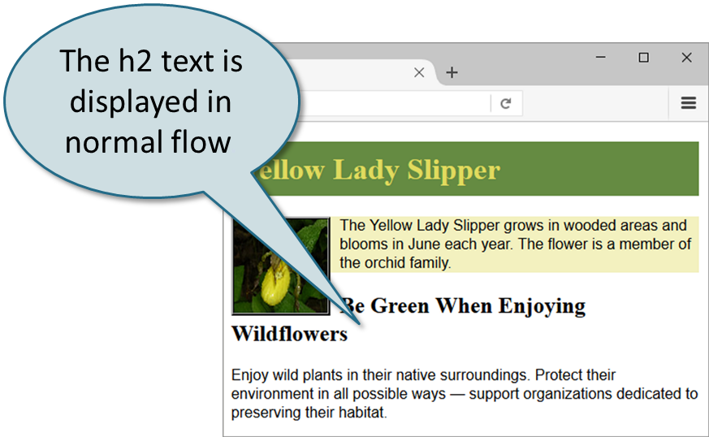
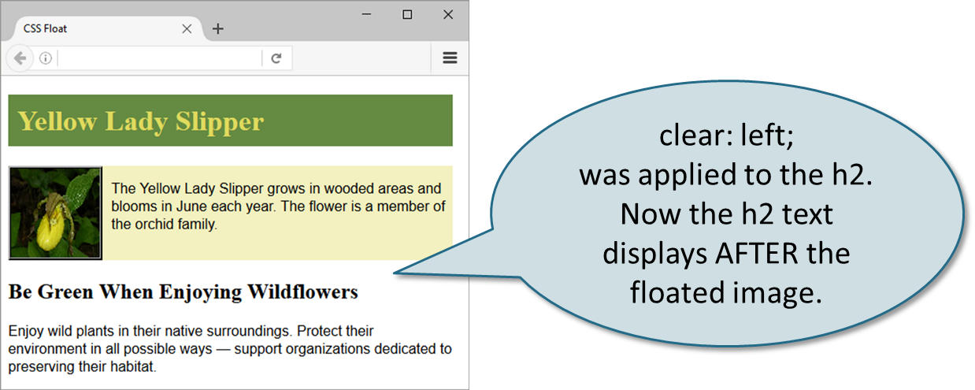
Clear Property
Useful to “clear” or terminate a float
Values are left, right, and both

Slide 10
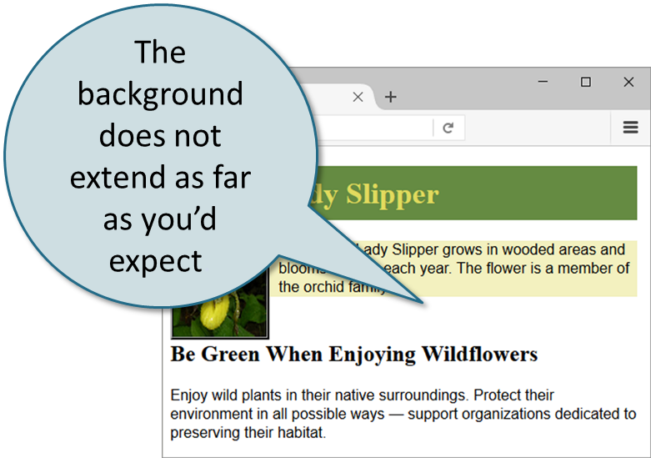
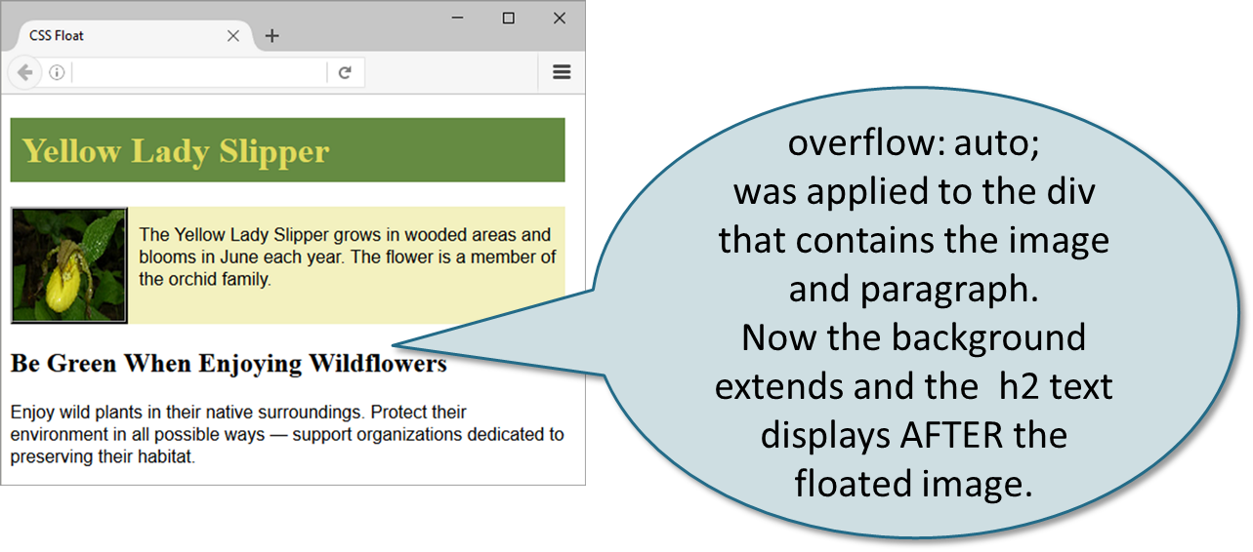
Overflow Property
Intended to configure the display of elements on a Web page.
However, it is useful to “clear” or terminate a float before the end of a container element
Values are auto, hidden, and scroll

Slide 11
Checkpoint 6.1
List the components of the box model from innermost to outermost.
Describe the purpose of the C S S float property.
Which two C S S properties can be used to clear a float?

Slide 12
C S S Display Property (1 of 2)
Configures how and if an element is displayed
display: none;
The element will not be displayed.
display: block;
The element is rendered as a block element – even if it is actually an inline element, such as a hyperlink

Slide 13
C S S Display Property (2 of 2)
display: inline;
The element will be rendered as an inline element – even if it is actually a block element – such as a <li>.
display: inline-block;
The element will display as an inline display element adjacent to other inline display elements but also can be configured with properties of block display elements including width and height.

Slide 14
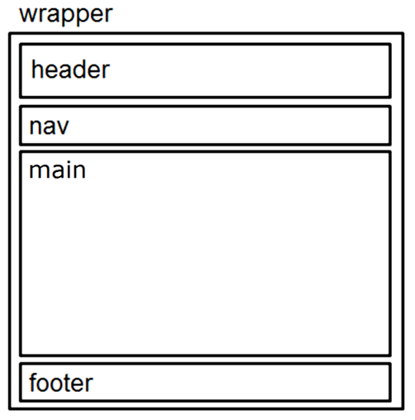
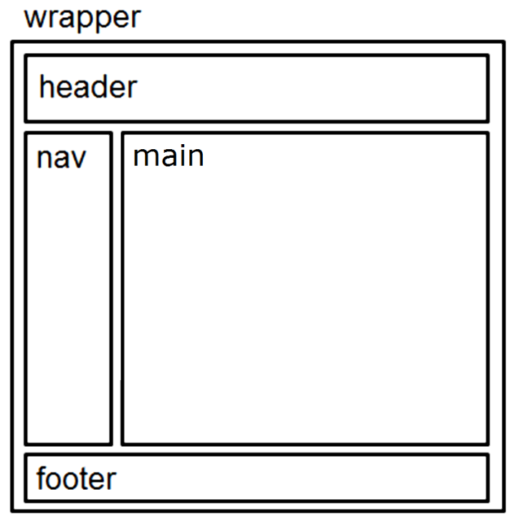
Page Layout Single Column → Two Column
Single Column Wireframe
Two Column Wireframe

Slide 15
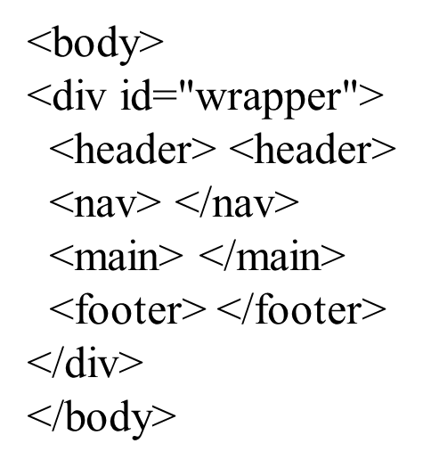
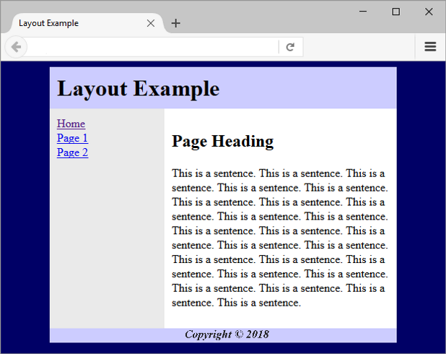
Basic Two-Column Layout (1 of 2)

Slide 16
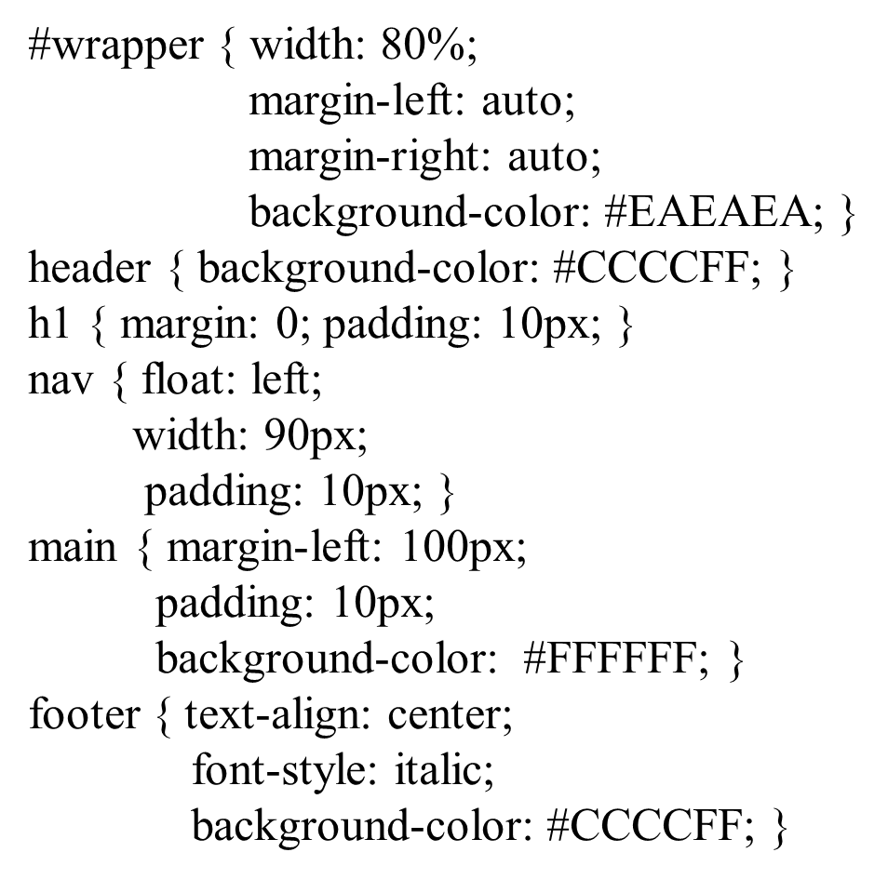
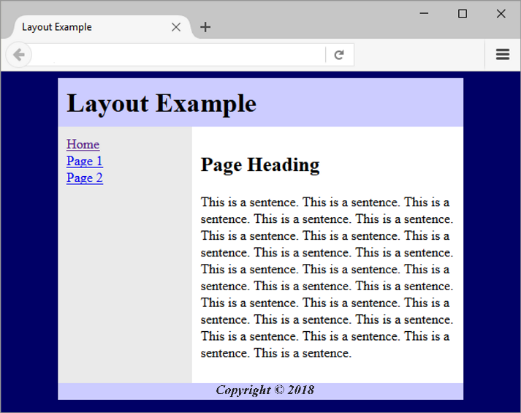
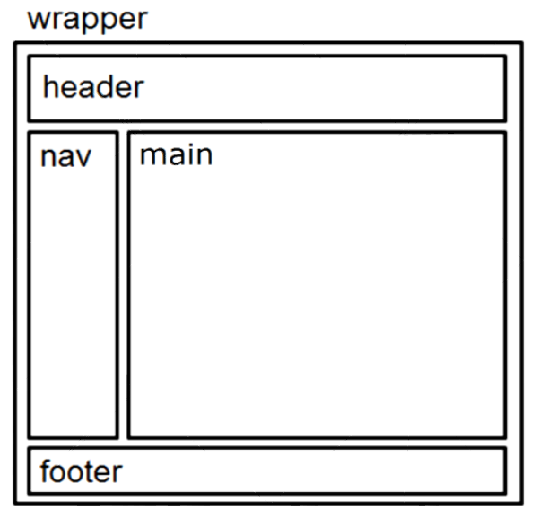
Basic Two-Column Layout (2 of 2)

Slide 17
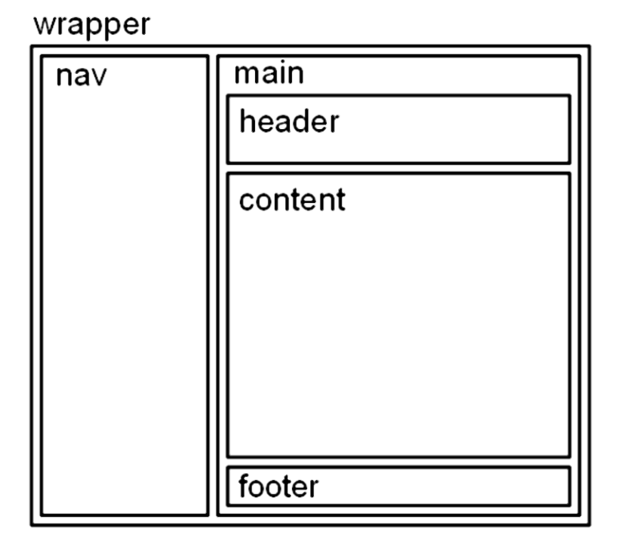
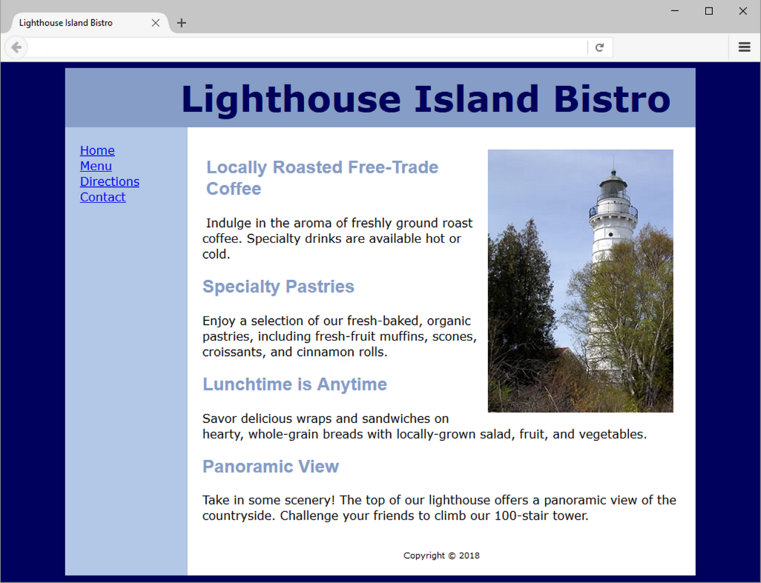
C S S Page Layout Two Columns (Left Nav)

Slide 18
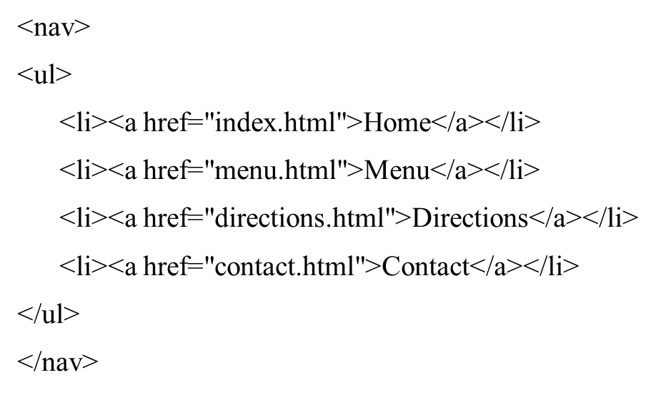
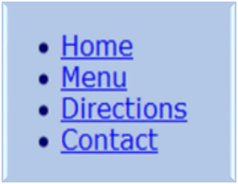
Vertical Navigation (1 of 2)

Slide 19
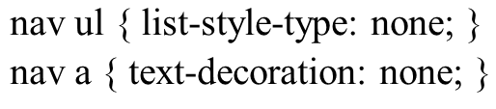
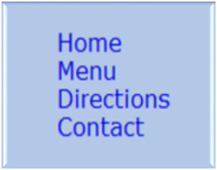
Vertical Navigation (2 of 2)
C S S removes the list marker and underline:

Slide 20
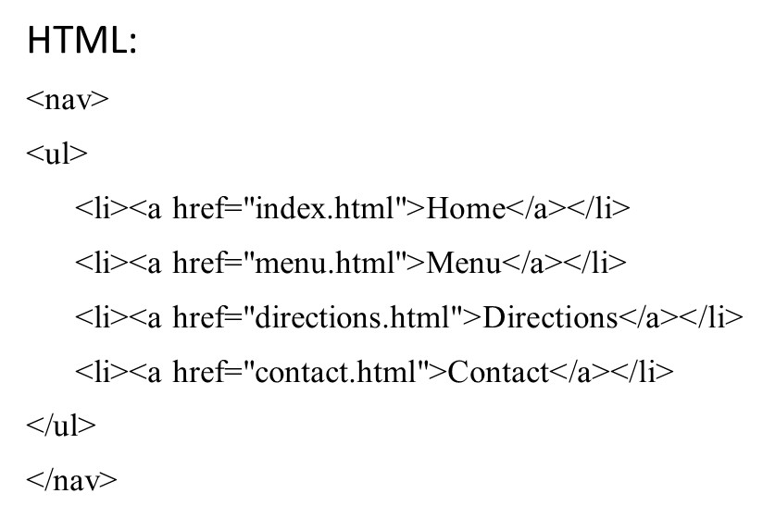
Horizontal Navigation (1 of 2)

Slide 21
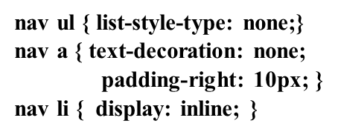

Horizontal Navigation (2 of 2)
C S S removes the list marker, removes the underline, adds padding, and configures the list items for inline display.

Slide 22
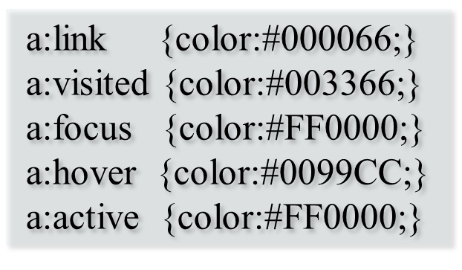
C S S Pseudo-Classes (1 of 2)
Pseudo-classes and the anchor element
link – default state for a hyperlink
visited – a hyperlink that has been visited
focus – triggered when the hyperlink has focus
hover – triggered when the mouse moves over the hyperlink
active – triggered when the hyperlink is being licked

Slide 23
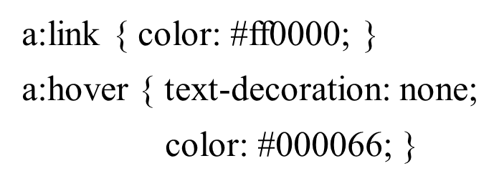
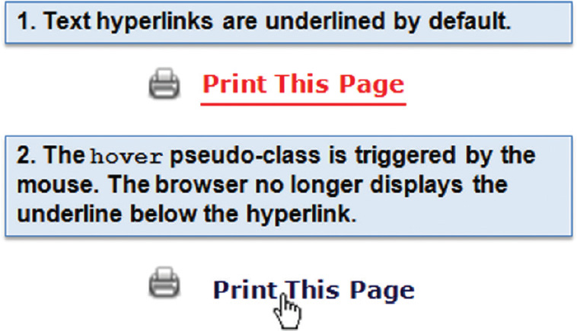
C S S Pseudo-Classes (2 of 2)

Slide 24
Header Text Image Replacement (1 of 2)
Useful when a non web-safe font must be used in the header logo banner area
Display the banner image but also configure text in the h1 for use by search engines and assistive technologies.
Configure styles for the header element set the header banner image as the background of the header or h1 element.
Code the company or website name with the h1 element.
Configure the placement of the h1 text to be beyond the browser viewport:

Slide 25
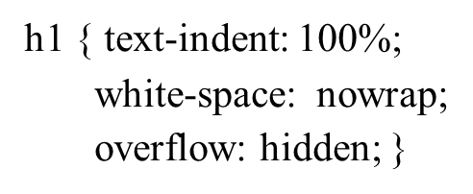

Header Text Image Replacement (2 of 2)
Source: http://www.zeldman.com/2012/03/01/replacing-the-9999px-hack-new-image-replacement/

Slide 26
Position Property
Value | Purpose
static | Default value; the element is rendered in normal flow
fixed | Configures the location of an element within the browser viewport; the element does not move when the page is scrolled
relative | Configures the location of an element relative to where it would otherwise render in normal flow
absolute | Precisely configures the location of an element outside of normal flow

Slide 27

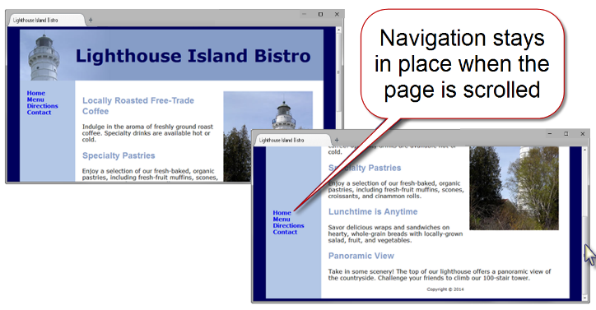
Fixed Positioning

Slide 28
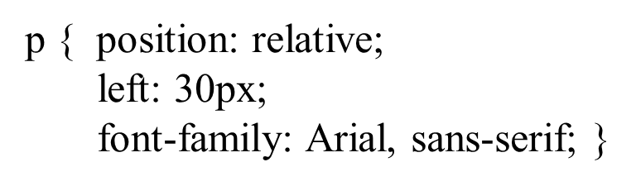
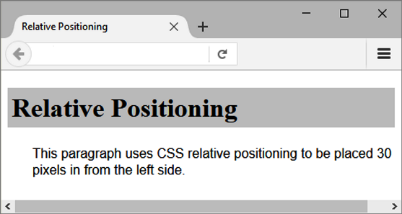
Relative Positioning
Changes the location of an element in relation to where it would otherwise appear in normal flow

Slide 29
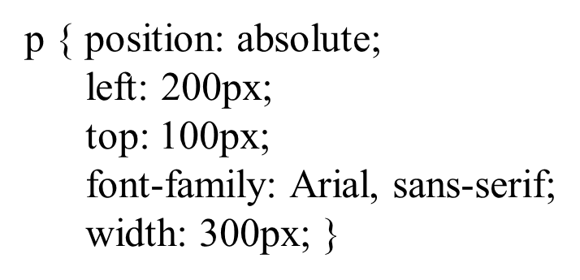
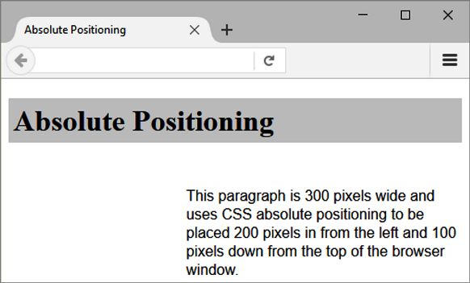
Absolute Positioning
Precisely specifies the location of an element outside of normal flow in in relation to its first parent non-static element

Slide 30
C S S Debugging Tips
Manually check syntax errors
Use W 3 C C S S Validator to check syntax errors
http://jigsaw.w3.org/css-validator/
Configure temporary background colors
Configure temporary borders
Use C S S comments to find the unexpected
/* the browser ignores this code */
Don’t expect your pages to look exactly the same in all browsers!
Be patient!

Slide 31
H T M L5 Structural Elements Review (1 of 2)
Header Element
block display; contains the headings of either a web page document or an area in the document such as a section or article
Nav Element
block display; contains a section of navigation hyperlinks
Main Element
block display; contains main page content

Slide 32
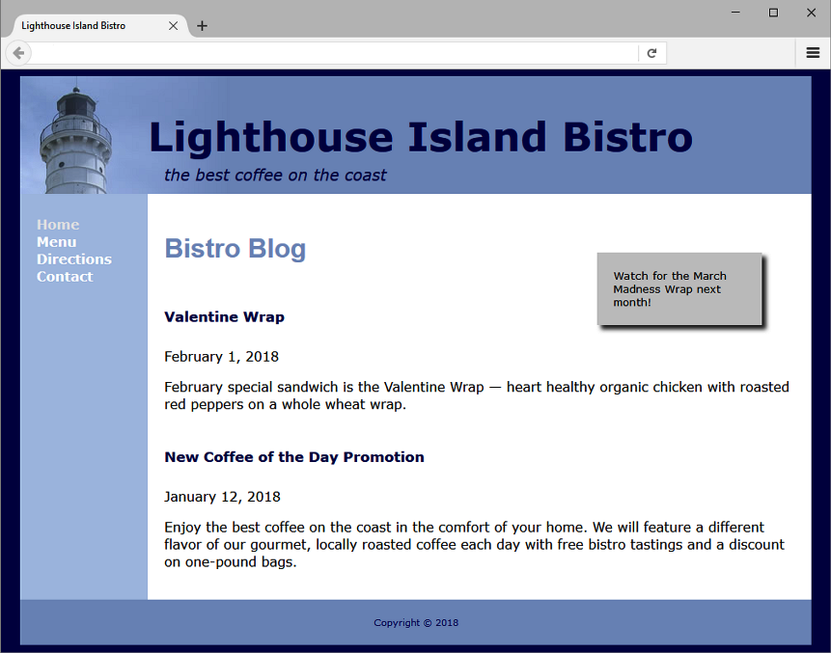
H T M L5 Structural Elements Review (2 of 2)
Footer Element
block display; contains the footer content of a web page or specific area (such as a section or article) on a web page

Slide 33
More H T M L5 Elements (1 of 2)
Aside Element
block display; contains a sidebar, a note, or other tangential content
Section Element
contains a “section” of a document, such as a chapter or topic
block display
Article Element
contains an independent entry, such as a blog posting, comment, or e-zine article that could stand on its own
block display

Slide 34

More H T M L5 Elements (2 of 2)
Time Element
represents a date or a time
could be useful to date articles or blog posts
inline display

Slide 35
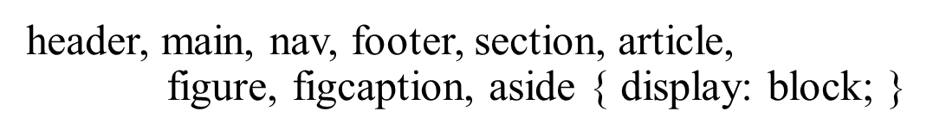
H T M L 5 Compatibility with Older Browsers
Configure Block Display with C S S

Slide 36
Deciding to Configure a Class or Id
Configure a class:
If the style may apply to more than one element on a page
Use the . (dot) notation in the style sheet.
Use the class attribute in the H T M L.
Configure an id:
If the style is specific to only one element on a page
Use the # notation in the style sheet.
Use the id attribute in the H T M L.

Slide 37
Checkpoint 6.2
Describe a reason to use H T M L5 structural elements instead of div elements for some page areas.
Describe one C S S debugging tip that you have found to be helpful.
Describe how to choose whether to configure an H T M L element selector, create a class, or create an id when working with C S S.

Slide 38
Summary
This chapter introduced you to the box model, C S S pseudo-classes, configuring two-column page layouts with C S S, and additional H T M L5 structural elements.

Slide 39
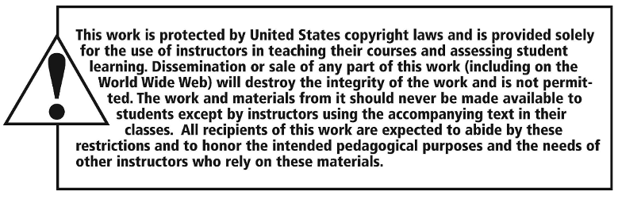
Copyright

